Slide 1
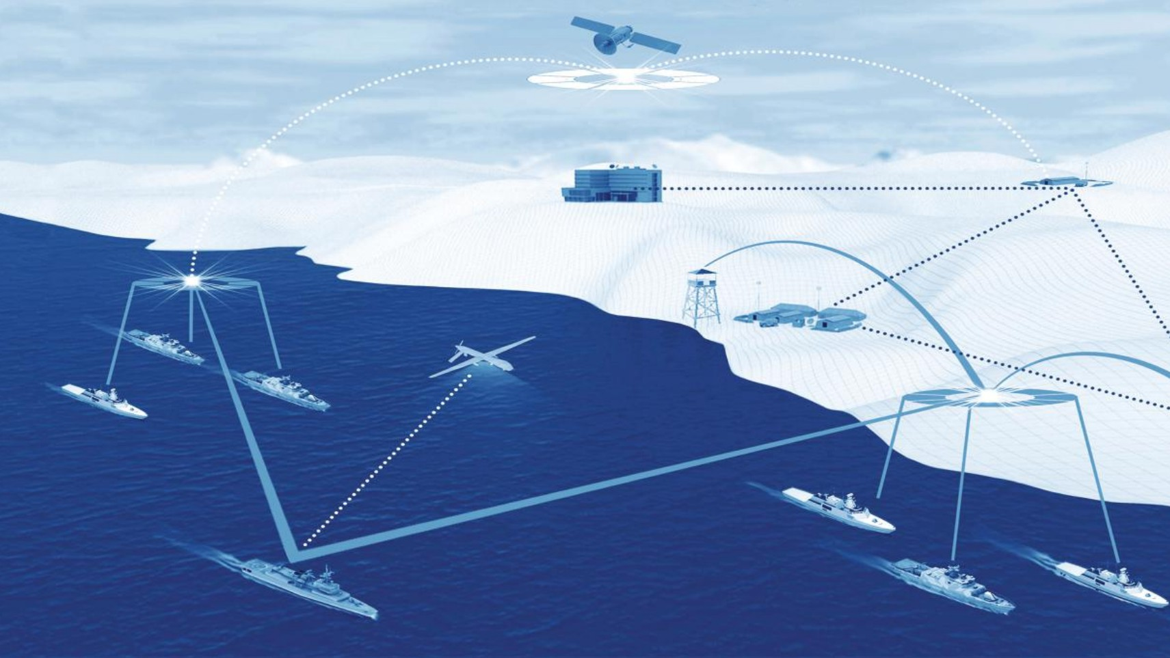
Shri Guru Gobind Singhji Institute of Engineering and Technology, Nanded
SELF-HEALING AUTONOMOUS MESH (SHAM) FOR RESILIENT NAVAL COMMUNICATIONS
A self-healing mesh network for resilient communication in disasters, maritime use, and conflict zones. Enables fishing boats to stay connected via multi-hop links without infrastructure. Automatically reroutes data if nodes fail, ensuring reliable communication even during network disruptions or signal jamming.
Project Guide
DR. A.V. Nandedkar

Slide 2
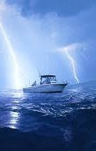
Problem statement
Maritime communication for fishing boats often depends on centralized infrastructure, making it unreliable during disasters, costly, and vulnerable to jamming. This project proposes a decentralized, mesh network that enables direct boat-to-boat communication without external infrastructure. Using Reinforcement Learning for adaptive routing and lightweight Ascon encryption for secure data transfer, the system ensures reliable, energy-efficient, and self-healing communication. It is specifically designed to support fishing communities and disaster management scenarios, improving safety, coordination, and real-time connectivity in remote and emergency conditions.
.

Slide 3
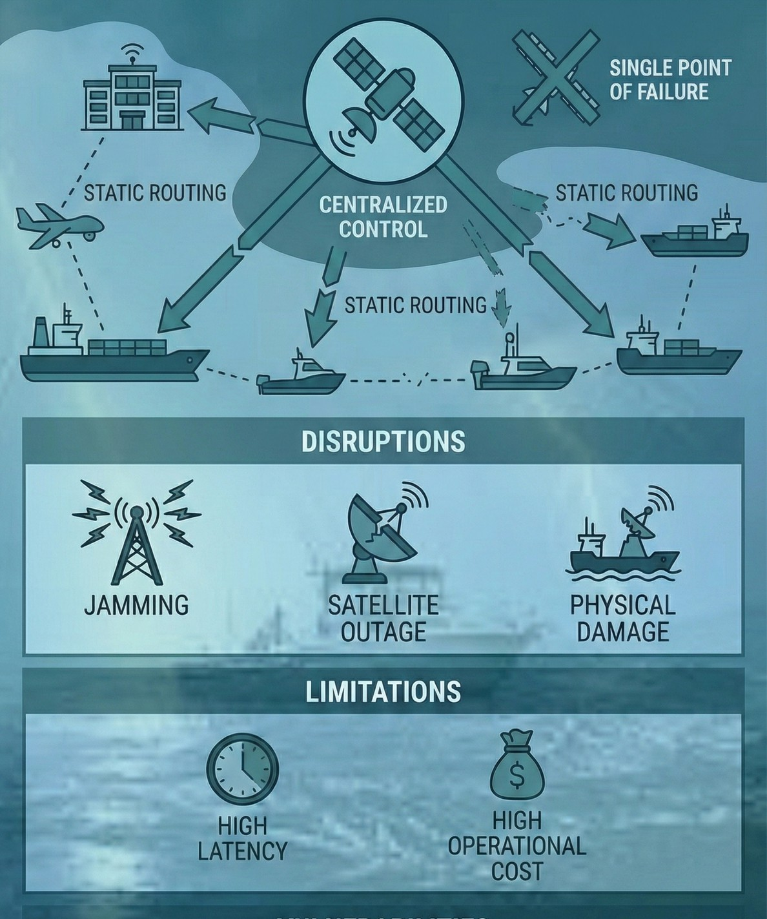
Existing Communication Systems
The main problems are:
Overdependence on Infrastructure: Most systems (satellite, cellular, coastal towers) require external infrastructure. During disasters, this infrastructure can fail, leaving boats completely disconnected.
Limited Range in Affordable Systems: Low-cost options like VHF/UHF radios work only over short distances, making them ineffective in deep-sea or dispersed fleet scenarios.
High Cost Barrier: Satellite communication and advanced equipment are too expensive for small-scale fishing communities, limiting accessibility.

Slide 4
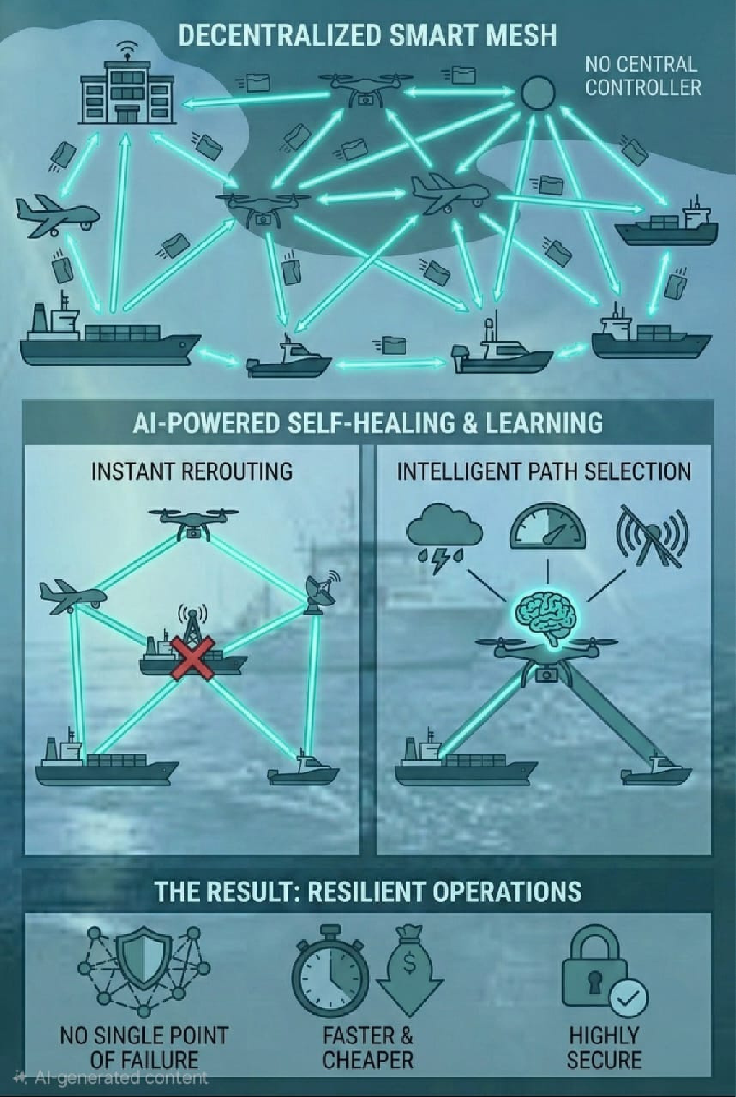
Solution
The Solution: A Smart, Self-Healing Network for Fishing Boats & Disaster Response
We are building a decentralized communication network where every fishing boat, rescue vessel, or coastal station acts as an independent node. Instead of relying on satellites or coastal towers, these nodes directly communicate with each other to maintain connectivity even in remote seas or disaster situations.
How it works:
Self-Healing: If a signal is lost due to bad weather, interference, or a node going offline, the network automatically reroutes communication through nearby boats, ensuring continuous connectivity.
Best Route Synchronization: The system continuously updates and selects the most efficient communication path based on distance, signal strength, and network conditions, ensuring fast and reliable data transfer.
No Single Point of Failure: With no central infrastructure, the network remains operational even if some nodes fail, making it highly resilient during cyclones, storms, or emergencies.
The Result: A reliable, low-cost, and secure communication system that keeps fishing communities connected, improves coordination during disasters, and enables real-time emergency response even in deep-sea and infrastructure-less environments.

Slide 5
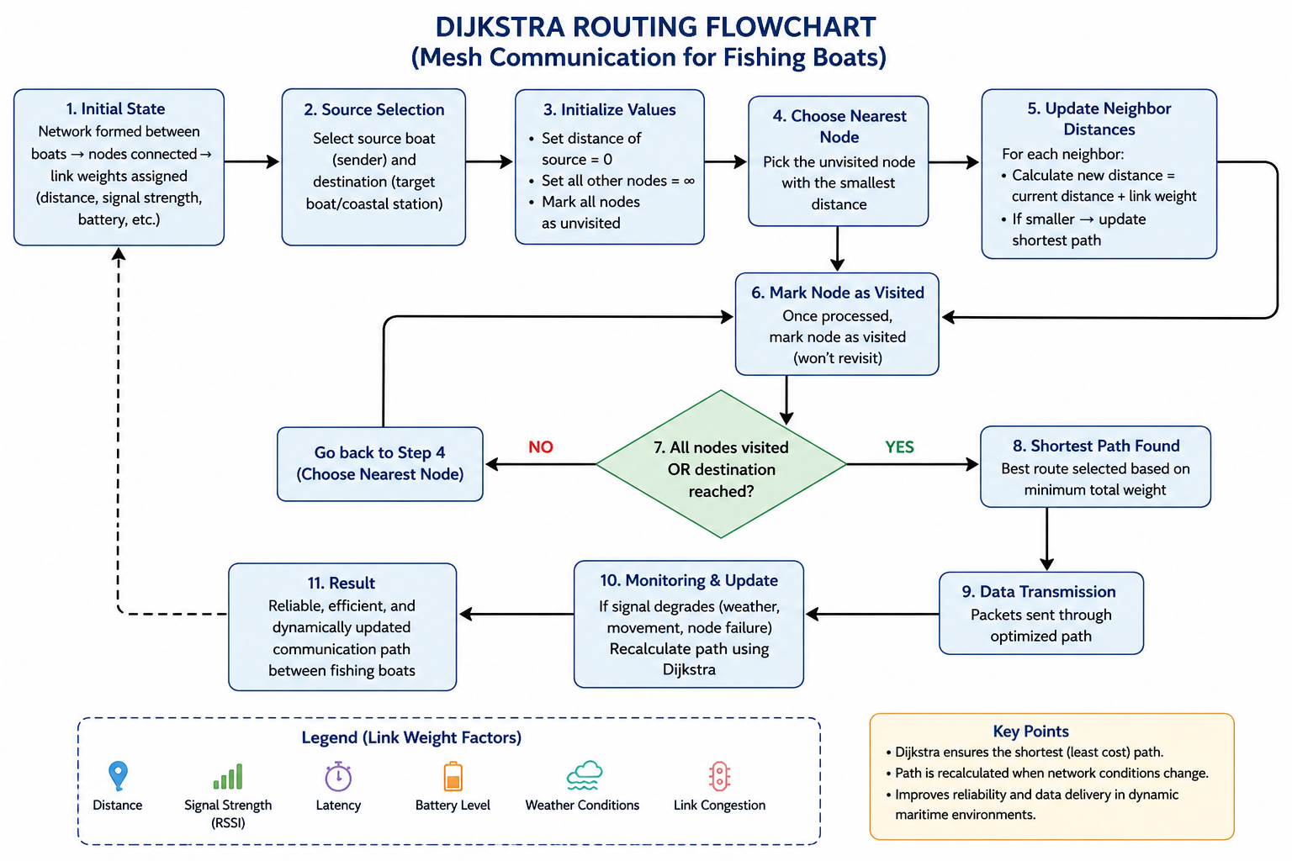
Dijkstra Algorithm
Optimal Route Selection: Dijkstra ensures data always travels through the shortest and most reliable path between boats, reducing delay and improving communication speed.
Better Signal Utilization: By selecting routes based on link quality (signal strength, distance), it avoids weak or unstable connections, ensuring clearer communication.
Reduced Packet Loss: Efficient path calculation minimizes transmission errors and dropped messages, which is critical during emergencies.
Energy Efficiency: Choosing shorter and stable paths reduces retransmissions and power usage—important for battery-powered devices on fishing boats.

Slide 6
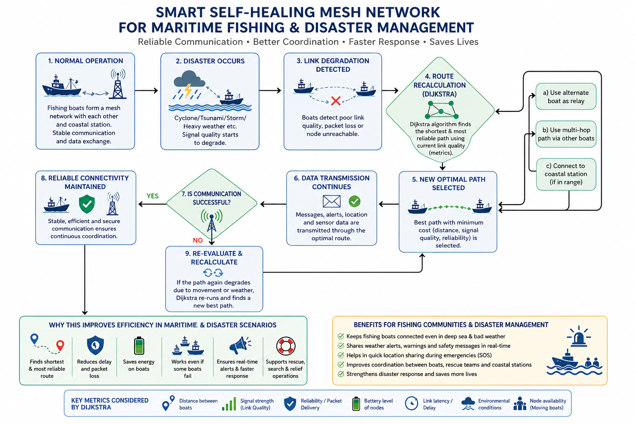

Slide 7
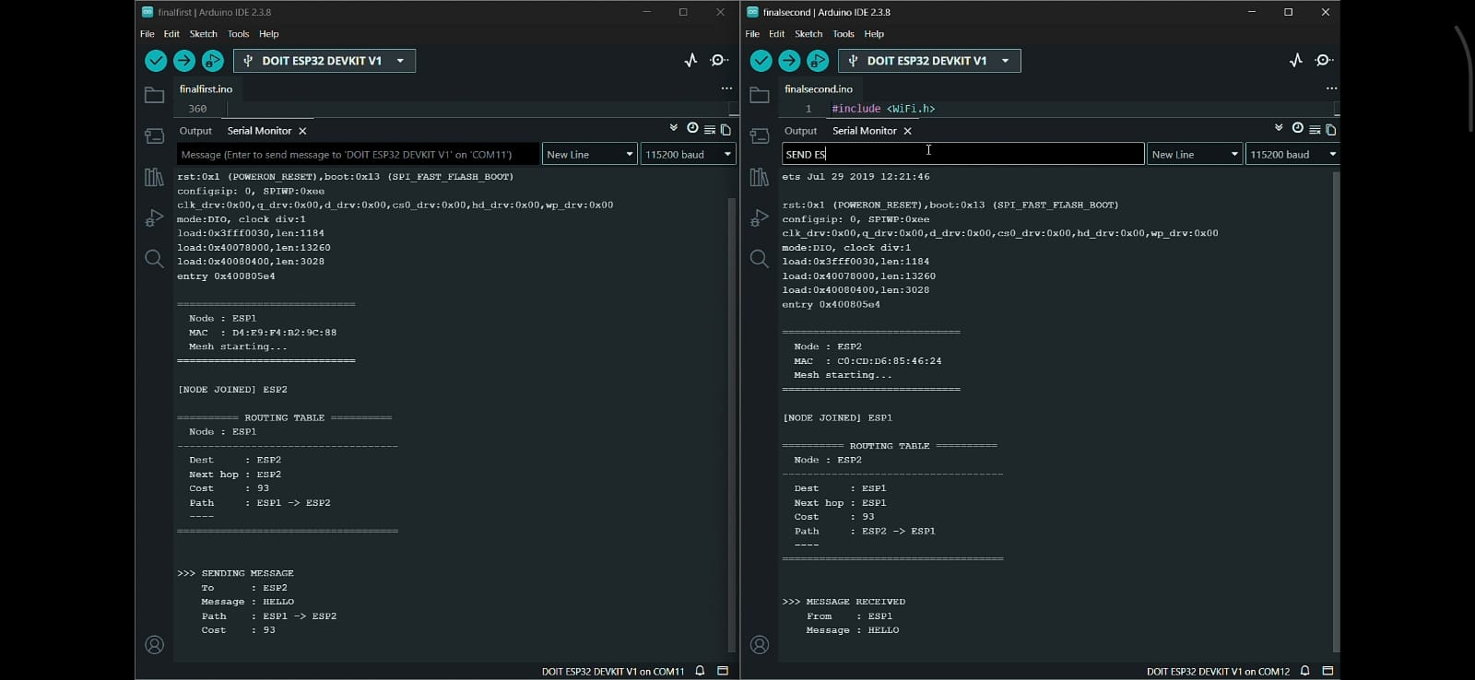

Slide 8
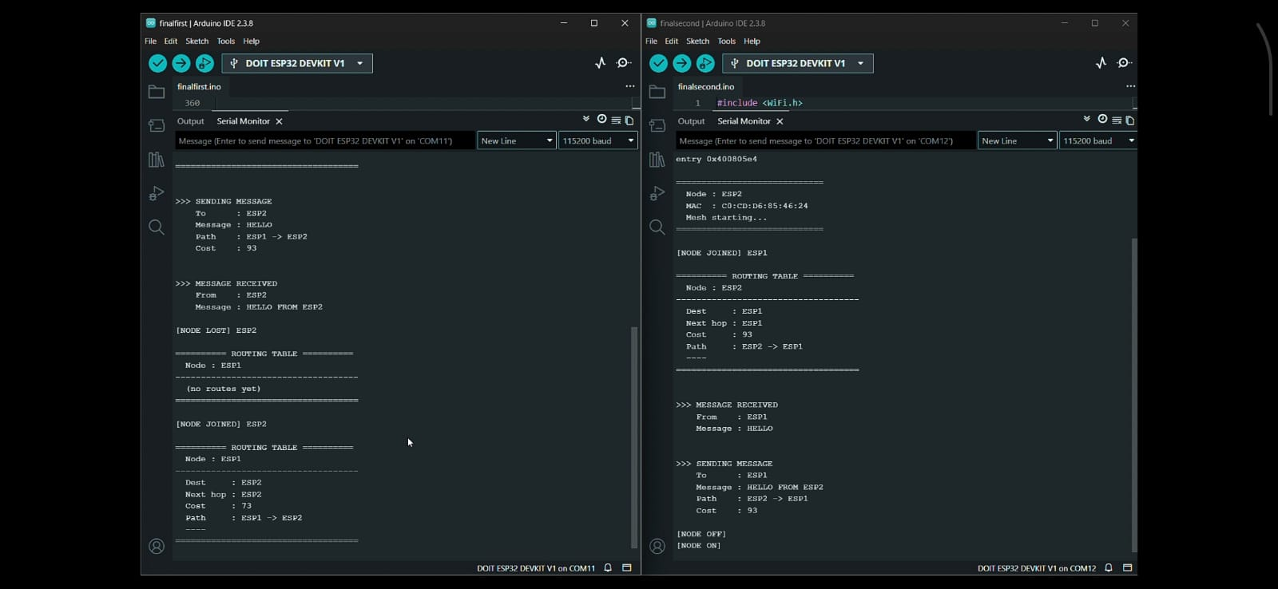

Slide 9

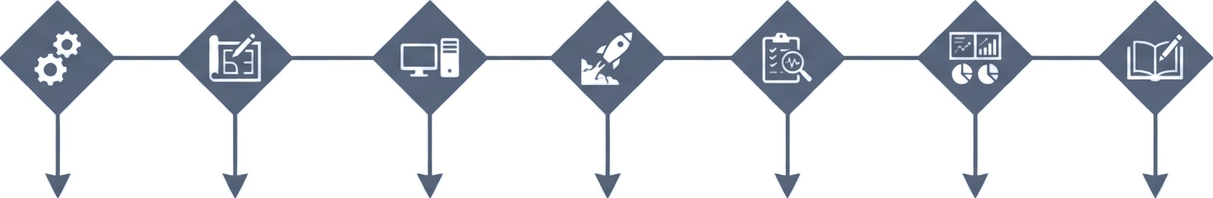
Phase 1: | Phase 2: | Phase 3: | Phase 4: | Phase 5: | Phase 9: | Phase 7:
Problem Analysis | System | Hardware & | Implementation | Testing & | Result | Documentation
& Requirement | Architecture | Software |  | Validation | Analysis &
Study | Design | Setup |  |  | Optimization

Slide 10
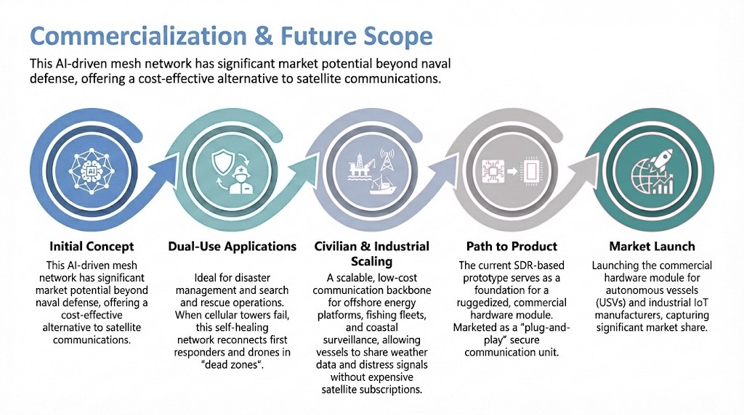
Commercialization & Future Scope
This AI-driven mesh network has significant market potential beyond naval defense, offering a cost-effective alternative to satellite communications.
Dual-Use Applications: The system is ideal for disaster management and search and rescue operations. When cellular towers fail during
floods or hurricanes, this self-healing network can be instantly
deployed to reconnect first responders and drones in "dead zones."
Civilian & Industrial Scaling: It offers a scalable, low-cost
communication backbone for offshore energy platforms, fishing fleets, and coastal surveillance, allowing vessels to share weather data and
distress signals without expensive satellite subscriptions.
Path to Product: The current SDR-based prototype serves as a
foundation for a ruggedized, commercial hardware module. This can be marketed as a "plug-and-play" secure communication unit for
autonomous vessels (USVs) and industrial IoT manufacturers.

Slide 11
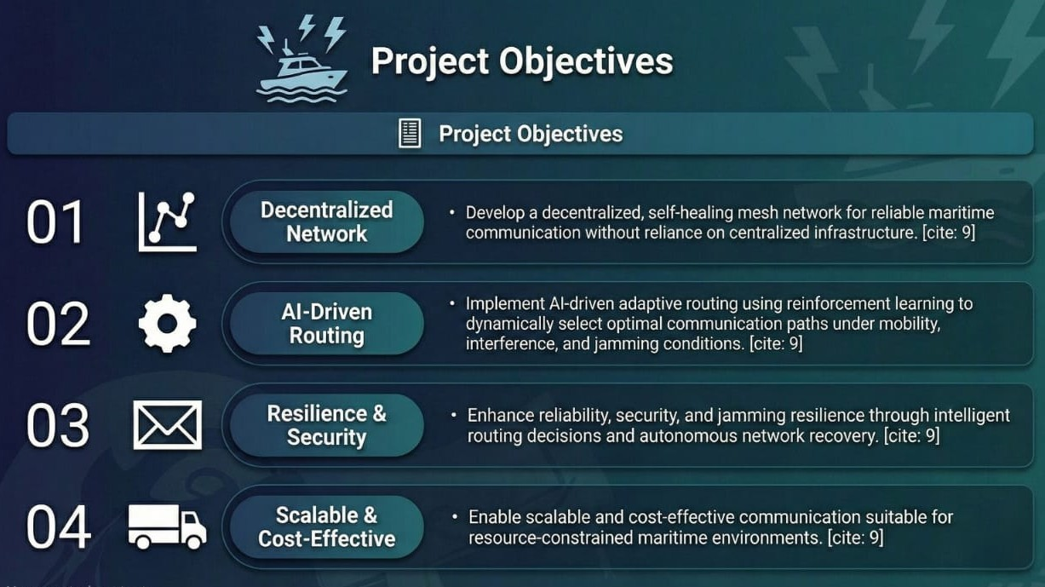

Slide 12
Video Demo :
https://drive.google.com/file/d/1WOdy535DaGs-zP9U97azA8G__Pl-C75O/view?usp=drive_link
GitHub Link :
https://github.com/AdarshCodeRealm/SHMN-Naval-Communication/

Slide 13
Thank you very much!

